Slide 1
BHARTI INFOTECH AND SERVICES
Bilaspur , Chhattisgarh
Introduction to Resister

Slide 2
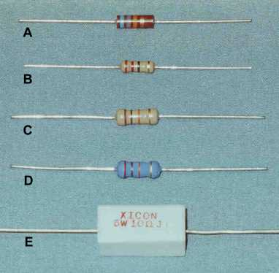
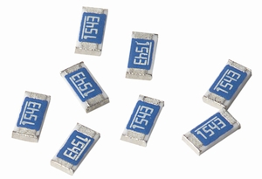
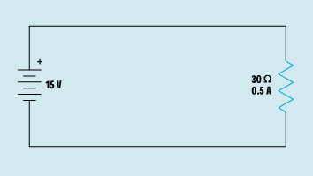
Resistors
Resistors can be either fixed or variable in value
Axial lead resistors have the value of resistance printed on them or as a colour code
Surface mount resistors have a numerical code indicating a value
All resistors have a tolerance a
I = E / R
I = 15 V / 30 Ω
I = 0.5 A

Slide 3
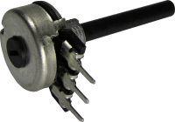
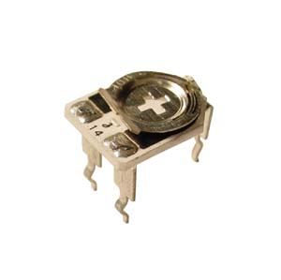
Resistors
Variable resistors are called potentiometers
There is a fixed value of resistance between two terminals.
The moving part of the potentiometer is called the wiper
Resistors are commonly used to perform two functions in a circuit.
The first use is to limit the flow of current in a circuit.

Slide 4
Resistors
Four band resistor colour code
1st band provides the first digit of the code
2nd band provides the second digit of the code
3rd band is the multiplier
4th band indicates the tolerance value

Slide 5
Resistors
Resistor colour code calculation
The first band red has a value of 2
The second band purple has a value of 7
The third band has a multiplier of x 10
The last band indicates a tolerance value of +/-5%
Resistance value is 270Ω +/-5%
2
7
x10
+/-5%

Slide 6
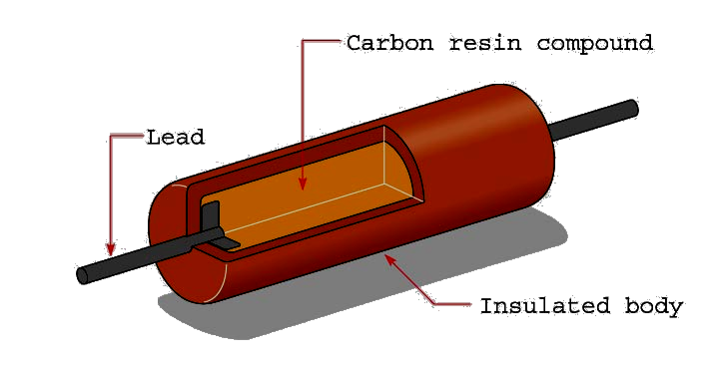
Fixed Resistors
Fixed resistors have only one ohmic value, which cannot be changed or adjusted. One type of fixed resistor is the composition carbon resistor.

Slide 7
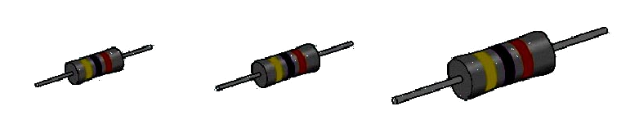
Carbon Resister
Carbon resistors are very popular for most applications because they are inexpensive and readily available in standard sizes and wattages.
½ Watt
1 Watt
2 Watt

Slide 8
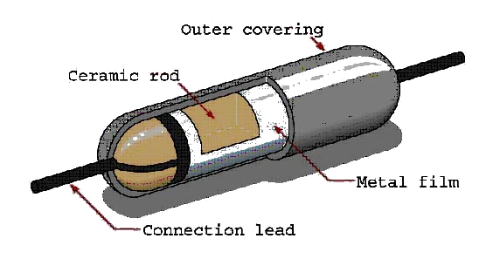
Metal Film Resister
Metal film resistors are another type of fixed resistor. These resistors are superior to carbon resistors because their ohmic value does not change with age and they have improved tolerance.

Slide 9
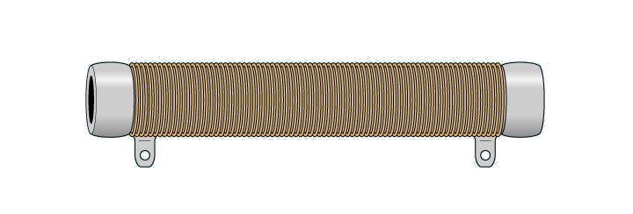
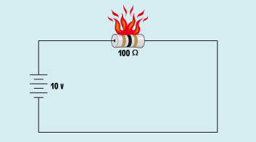
Wired-Wound
Wire-wound resistors are fixed resistors that are made by winding a piece of resistive wire around a ceramic core. These are used when a high power rating is required.
Exceeding the power rating causes damage to a resistor.

Slide 10
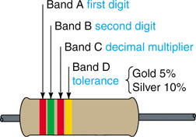
Resistor Color Coding
Resistor Color Code
Color Code
0 Black
1 Brown
2 Red
3 Orange
4 Yellow
5 Green
6 Blue
7 Violet
Fig.- How to read color stripes on carbon resistors for R in ohms.
8 Gray
9 White

Slide 11
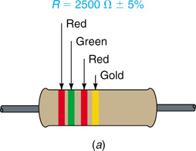
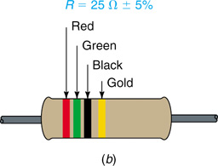
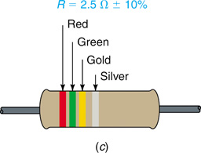
Resistor Color Coding
Resistors under 10 Ω:
  The multiplier band is either gold or silver.
    For gold, multiply by 0.1.
    For silver, multiply by 0.01.
Fig.- Examples of color-coded R values, with percent tolerance.

Slide 12
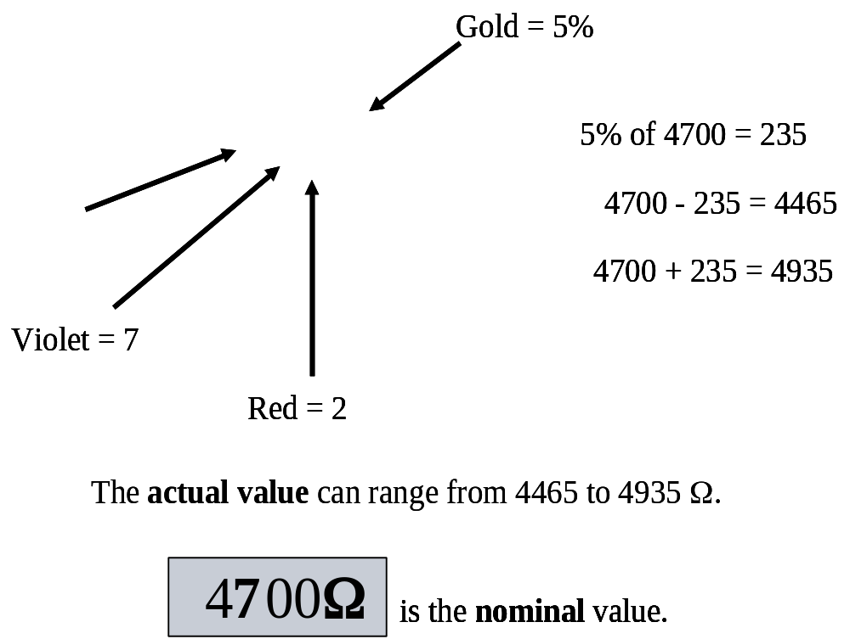
Resistor Color Coding
Applying the Color Code
  The amount by which the actual R can differ from the color-coded value is its tolerance. Tolerance is usually stated in percentages.
Yellow = 4

Slide 13
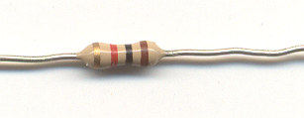
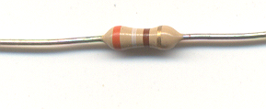
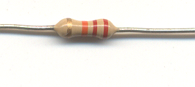
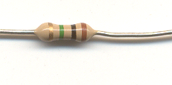
Resistor Color Coding
What is the nominal value and permissible ohmic range for each resistor shown?
1 kΩ (950 to 1050 Ω)
390 Ω (370.5 to 409.5 Ω)
22 kΩ (20.9 to 23.1 kΩ)
1 MΩ (950 kΩ to 1.05 MΩ)

Slide 14
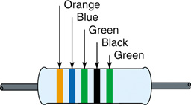
Resistor Color Coding
Five-Band Color Code
  Precision resistors often use a five-band code to obtain more accurate R values.
  The first three stripes indicate the first 3 digits in the R value.
  The fourth stripe is the multiplier.
  The tolerance is given by the fifth stripe.
    Brown = 1%
    Red = 2%
    Green = 0.5%
    Blue = 0.25%
    Violet = 0.1%.
Fig.-Five-band code.

